Slide 1
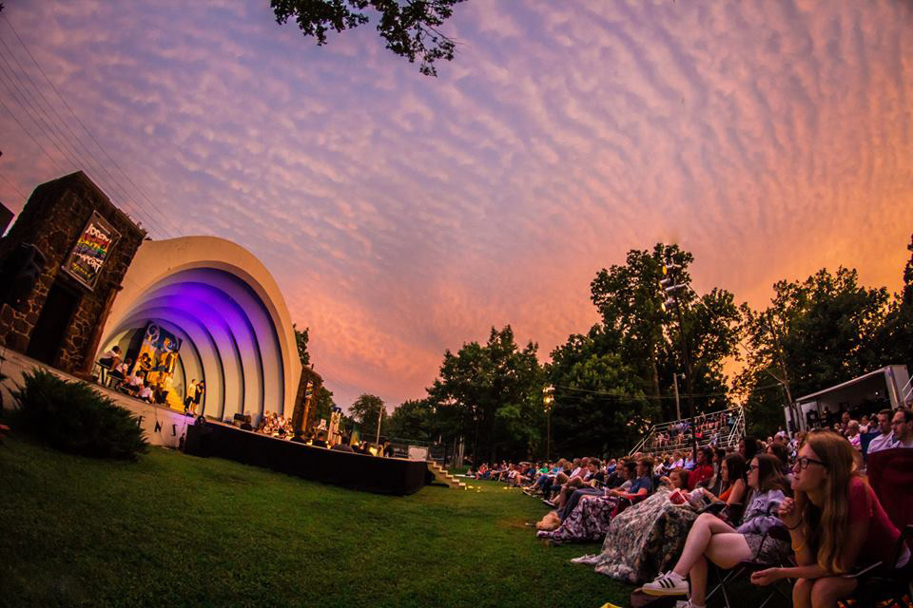





2024
Community Benchmark Report
City of Lindsborg, KS
Be The Movement! Connect with local changemakers, local community projects, resources & grants, and much more. www.mcphersonfoundation.org.com
Betsy Davis | betsy@mcphersonfoundation.org

Slide 2
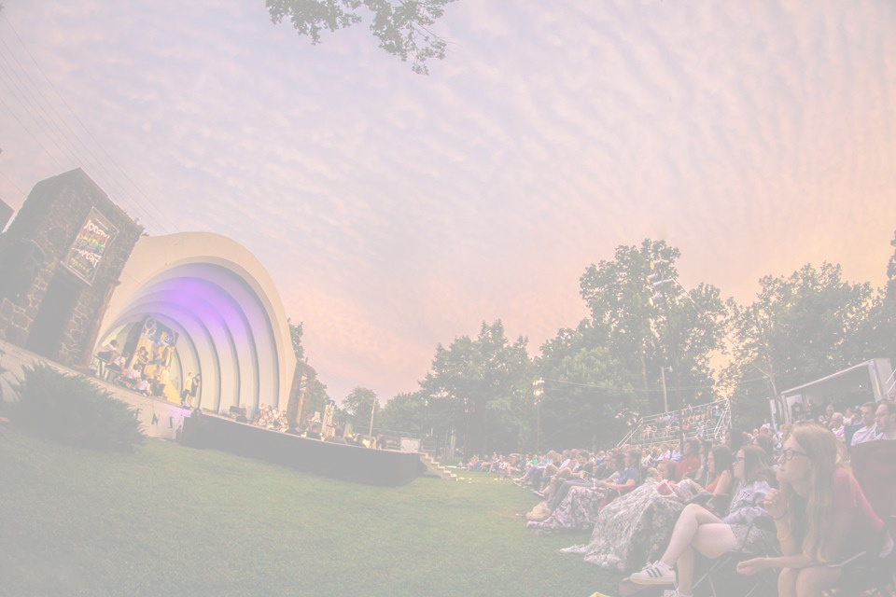









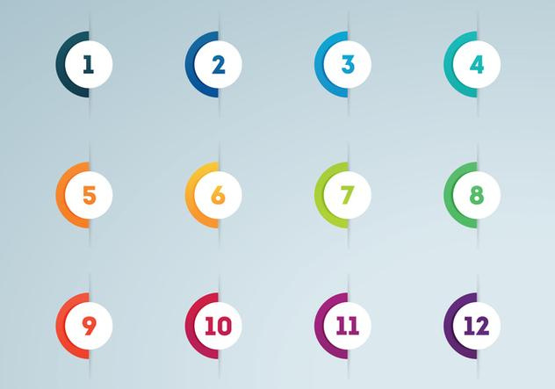



Community Benchmarking Report City of Lindsborg, KS | 2024
The Community Benchmarking report has been commissioned by McPherson County Community Foundation to help local residents gain a better understanding of the most pressing opportunities that the local towns face. The annual reports that are generated will help leaders determine the extent to which the efforts are having an impact on the local residents. The reports are also a way for the the various towns in McPherson County to pursue grants to help further their local efforts.
Local leaders can use this framework to help inspire change.
This report provides the clues on what the fellow residents are craving.
Collaborative Leadership
Committed Citizenship
Community
Economic & Community
Vision & Action
Sustainability

Slide 3


Community Benchmarking Report City of Lindsborg, KS | 2024
Who took the Survey
144
Total Responses
42
Number of people who expressed an interest in volunteering to better the community
42 of 144 (29%)
(The goal was 125)

Slide 4
Community Benchmarking Report City of Lindsborg, KS | 2024
What Makes Our Community
Special?
Local Leaders

Slide 5
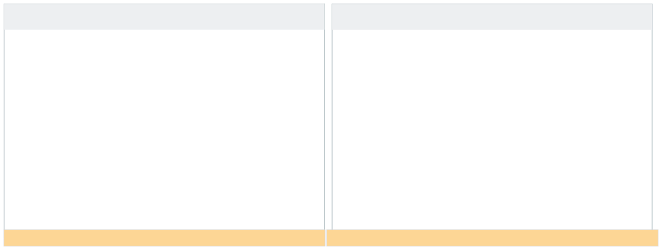
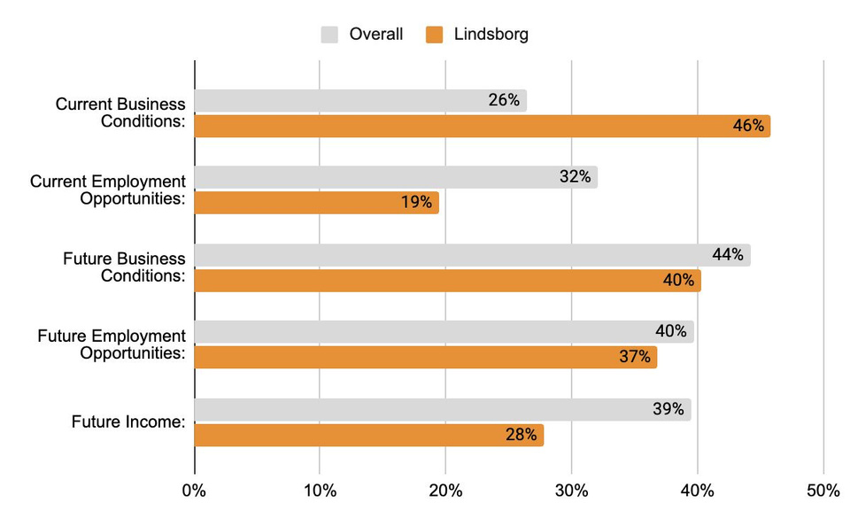

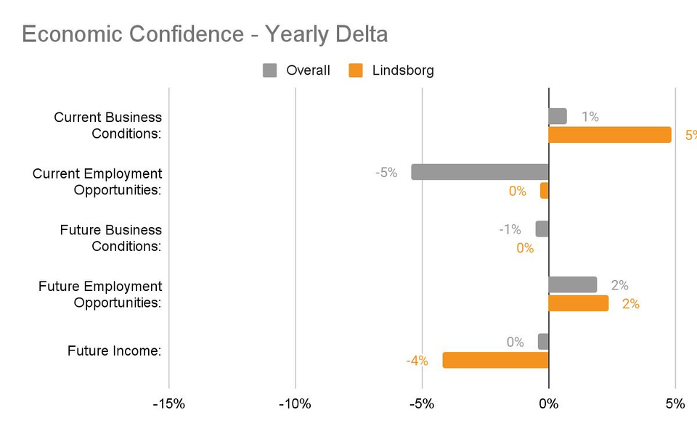



Community Benchmarking Report City of Lindsborg, KS | 2024
Economic Confidence
Our Economic Perceptions
Year Over Year Change (2023 vs 2024)
Business conditions are perceived well but possibly not as much in the future.
Business conditions perception increased from last year with a drop in future income.

Slide 6
Community Benchmarking Report City of Lindsborg, KS | 2024
Economic Confidence
How might the Lindsborg community foster local business growth?
What businesses are missing from the “needed in our town list”?

Slide 7
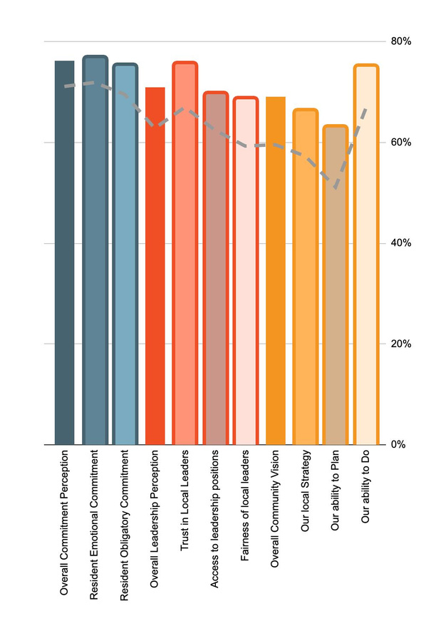
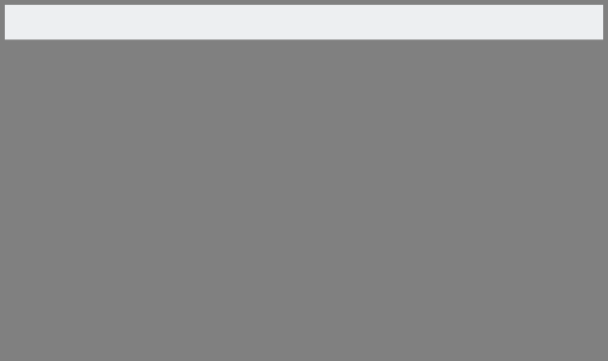
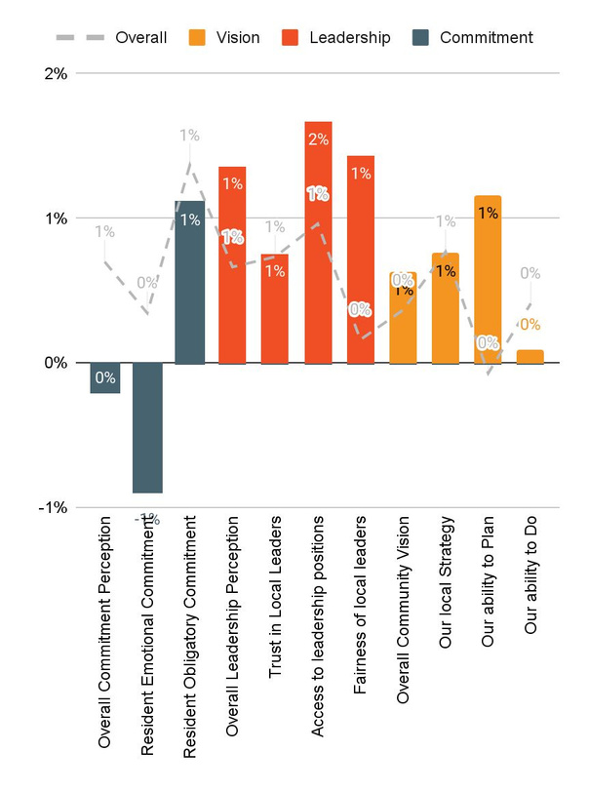

Community Benchmarking Report City of Lindsborg, KS | 2024
Community Engagement
How do our residents view our community?
Year Over Year Change (2023 vs. 2024)

Slide 8
Community Benchmarking Report City of Lindsborg, KS | 2024
Community Engagement
What makes Lindsborg and its residents so special?
How can leaders inspire more emotional commitment to Lindsborg?
How can leaders commit to Vision?

Slide 9

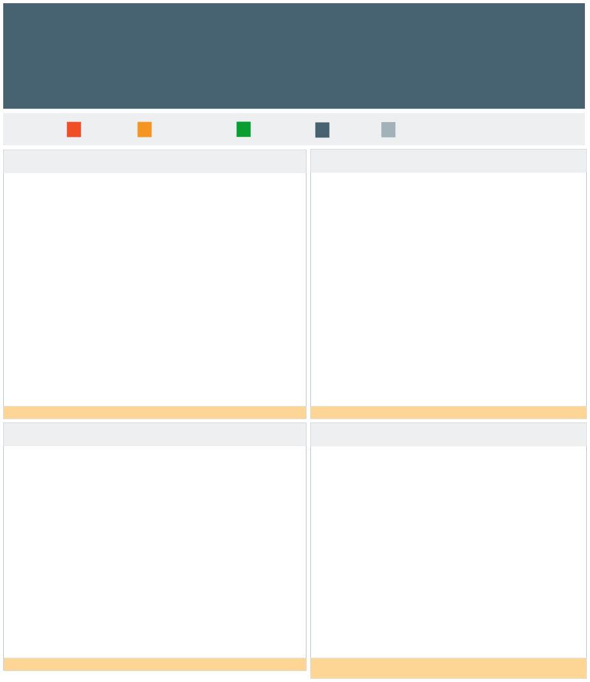
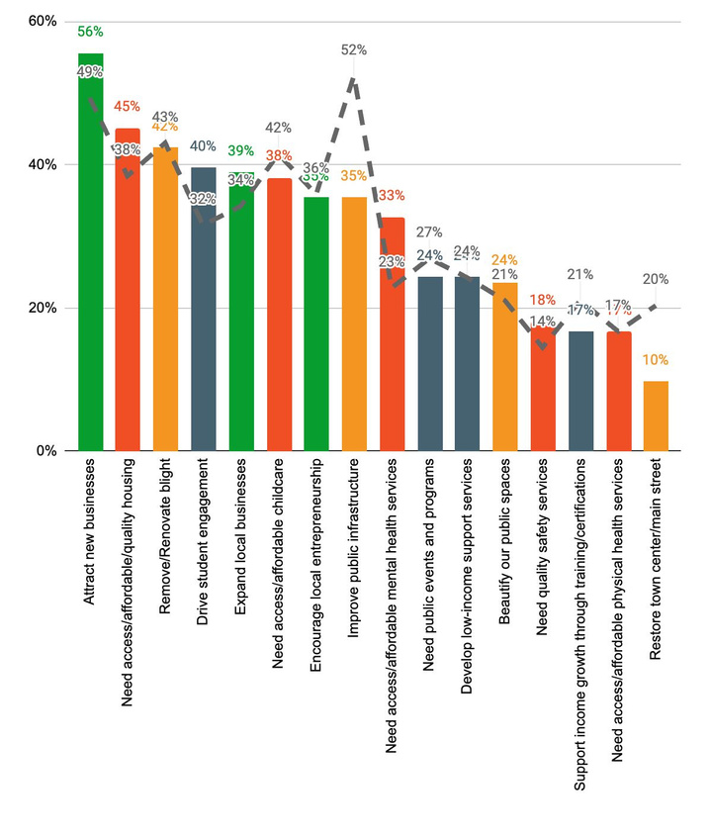
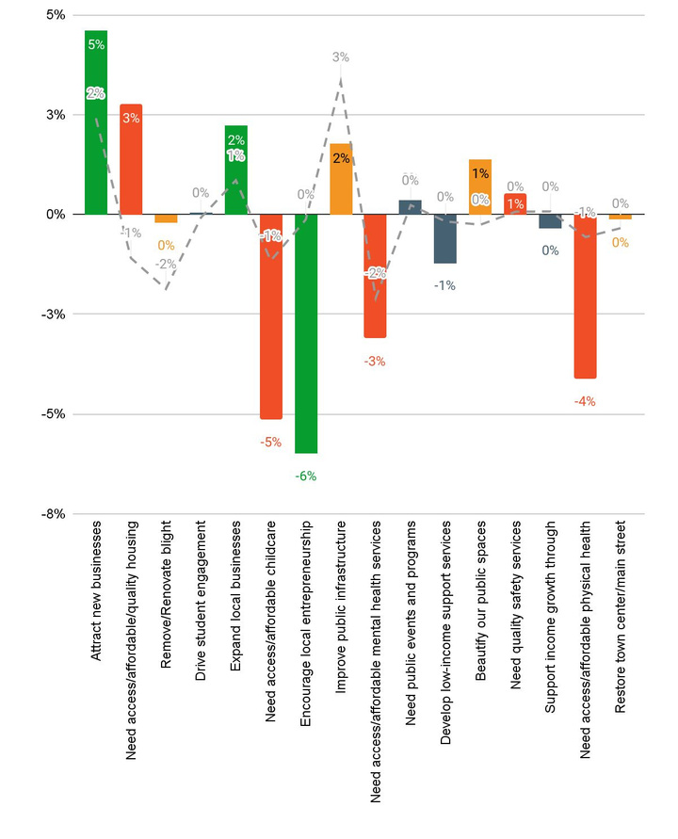
Community Benchmarking Report City of Lindsborg, KS | 2024
Community Priorities
2024 Program Priorities
Priority Shift (2023 vs 2024)
Focusing on economic priorities seems to have more weight.
Why would attracting new businesses not include entrepreneurship?

Slide 10
Community Benchmarking Report City of Lindsborg, KS | 2024
Community Priorities
What are some step that could be taken to address the highlighted issues?
How will Lindsborg measure progress on key priorities?

Slide 11
Community Benchmarking Report City of Lindsborg, KS | 2024
Moving forward
Community Priority Shift
Grant opportunities
  Mastermind
  County Grants
Priority Coalitions

Slide 12

Lets Continue the Conversation
  Fill Out the Card on your table
  Sign up for Our Newsletter
  Participate in continuing projects
Betsy Davis | betsy@mcphersonfoundation.org

